Slide 1
Notice and Respond: Assisting Students in Distress

Slide 2
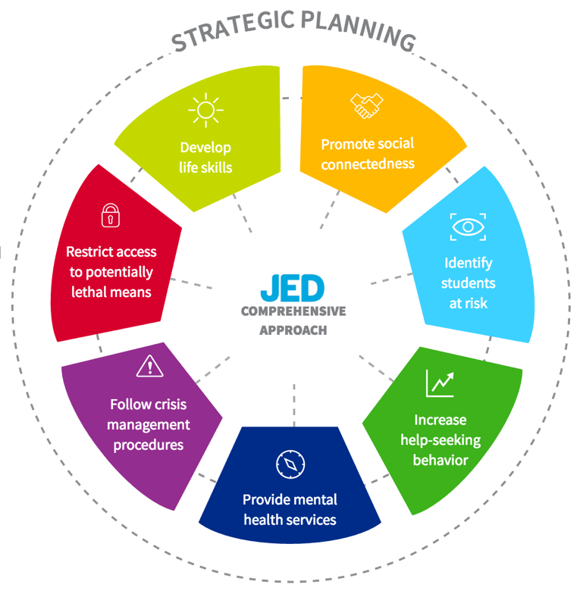

Slide 3
Notice and Respond: Assisting Students in Distress

Slide 4
Cast of Characters
Erica Lee - Student
Dr. Jack Allen – Faculty Member
Dr. Sondra Coleman – Faculty Member

Slide 5
Ways of Asking about Suicide
I am wondering if you’ve had thoughts about suicide.
Are you thinking of killing yourself?
Are you thinking about ending your life?
Are you considering suicide?

Slide 6
Signs of Distress
You might notice one serious sign or a cluster of signs, sometimes a sudden change is most noticeable
Emotional
Sadness, anxiety, crying, irritability, anger; showing extreme reactions; expressions of disinterest, apathy or hopelessness; suicidal comments
Cognitive
Decline in work or academic performance; poor concentration, impaired decision-making ability; out-of-touch with reality/odd speech
Physical
Frequent health issues; problems with sleep or eating; rapid heartbeat; disheveled appearance; social withdrawal; significant alcohol or drug use

Slide 7
Levels of Distress
Concern
Urgent
Emergency
Levels of Distress

Slide 8
Levels of Distress and Response Options
Concern – Visible distress, crying, irritability, anger fights/arguments, anxiety, personal loss or traumatic life event, decline in academic performance, social withdrawal, significant alcohol or drug use
What to do: Talk with the student directly, Listen, Validate Feelings consult with campus resources and/or Tell Someone who can follow through and coordinate university services.
Tell Someone: 970-491-1350
Keep your supervisor informed of the situation.

Slide 9
Levels of Distress and Response Options
Urgent – Expressions of hopelessness; talk of suicide (including vague threats or references to plans to end problems, go to sleep and not wake up etc.); “saying goodbye;” being out-of-touch with reality; talk about hurting others, new/increased fascination with weapons or incidents of workplace/mass violence.
What to do: Get immediate assistance
After hours (24/7): Counseling Services: 970-491-6053
and
Follow up with: Tell Someone: 970-491-1350
Keep your supervisor informed of the situation.

Slide 10
Levels of Distress and Response Options
Emergency – Immediate threat of suicide or harm to others. Talks openly/makes threats. Shows or talks about having weapons close at hand, becomes visibly physical/aggressive
What to do: Get immediate assistance
Call CSU Police at 911 or 970-491-6425
Keep your supervisor informed of the situation.

Slide 11
Response Options for a Colleague
Concern – Same: Tell Someone is for students, staff and faculty
Also: Ombuds Office & Employee Assistance 970-491-1527
Employee Assistance Program: 1-800-497-9133
Urgent – Same
What to do: Get immediate assistance
During business hours: Tell Someone: 970-491-1350
After hours (24/7): Mental Health Crisis Intervention:
970-491-6053
Emergency – Same
What to do: Get immediate assistance
Call CSU Police at 911 or 970-491-6425

Slide 12
Final Points
See Something Do Something
Everyone has a role to play in supporting mental health on this campus

Slide 13
Notice and Respond
www.health.colostate.edu/noticeandrespond
www.safety.colostate.edu/tell-someone.aspx
Email: janelle.patrias@colostate.edu
For more information and Tips on How to Help
Questions?

Slide 15
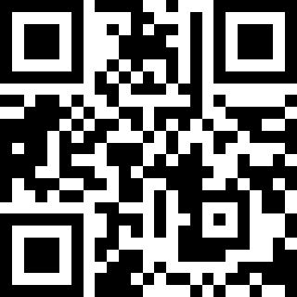
Feedback QR Code
Feedback-
https://tinyurl.com/4m7swvss
Notes:
Please fill out feedback form, it’s how we get better.

